Slide 1
MODULE 4 : UNSUPERVISED LEARNING
Notes:
In social networks, users develop rich, complex relationships with one another, but most network analysis reduces these relationships to simple links for research purposes. This paper looks deeper and examines network structure in the presence of both positive and negative links.
Prior evaluations of Structural Balance Theory
Empirical investigations generally focused on small networks with social relations observed through direct interaction
Bias toward abundance of certain kinds of triangles

Slide 2
Clustering in Machine Learning
Clustering or cluster analysis is a machine learning technique, which groups the unlabelled dataset. It can be defined as "A way of grouping the data points into different clusters, consisting of similar data points. The objects with the possible similarities remain in a group that has less or no similarities with another group."
It does it by finding some similar patterns in the unlabelled dataset such as shape, size, color, behavior, etc., and divides them as per the presence and absence of those similar patterns.
It is an unsupervised learning
method, hence no supervision is provided to the algorithm, and it deals with the unlabeled dataset.
After applying this clustering technique, each cluster or group is provided with a cluster-ID. ML system can use this id to simplify the processing of large and complex datasets.

Slide 3
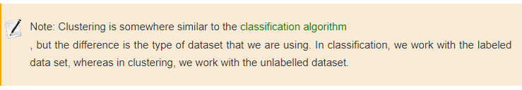
The clustering technique is commonly used for statistical data analysis.
Example: Let's understand the clustering technique with the real-world example of Mall: When we visit any shopping mall, we can observe that the things with similar usage are grouped together. Such as the t-shirts are grouped in one section, and trousers are at other sections, similarly, at vegetable sections, apples, bananas, Mangoes, etc., are grouped in separate sections, so that we can easily find out the things. The clustering technique also works in the same way. Other examples of clustering are grouping documents according to the topic.

Slide 4
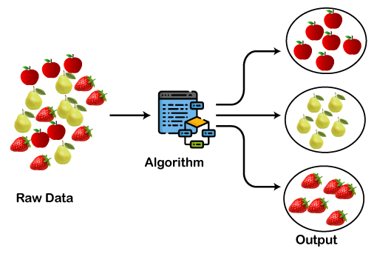
The clustering technique can be widely used in various tasks. Some most common uses of this technique are:
Market Segmentation
Statistical data analysis
Social network analysis
Image segmentation
Anomaly detection, etc.
Apart from these general usages, it is used by the Amazon in its recommendation system to provide the recommendations as per the past search of products. Netflix also uses this technique to recommend the movies and web-series to its users as per the watch history.
The below diagram explains the working of the clustering algorithm. We can see the different fruits are divided into several groups with similar properties.

Slide 5
Types of Clustering Methods
The clustering methods are broadly divided into Hard clustering (datapoint belongs to only one group) and Soft Clustering (data points can belong to another group also). But there are also other various approaches of Clustering exist. Below are the main clustering methods used in Machine learning:
Partitioning Clustering
Density-Based Clustering
Distribution Model-Based Clustering
Hierarchical Clustering
Fuzzy Clustering

Slide 6
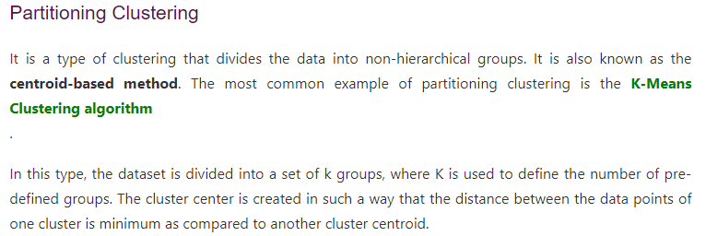
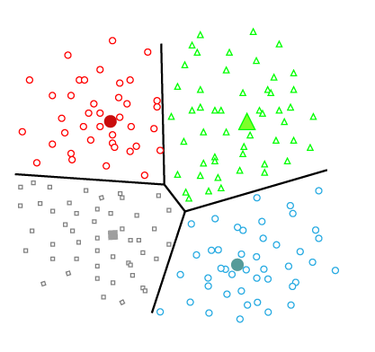

Slide 7
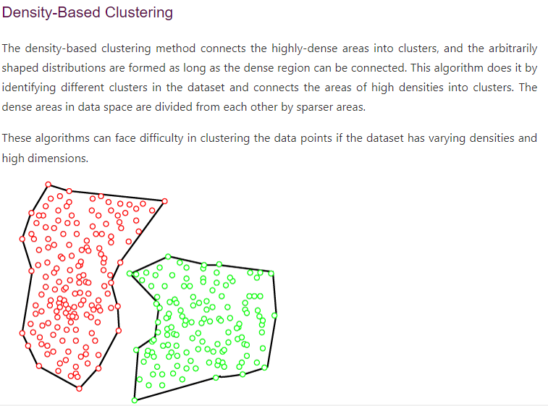

Slide 8
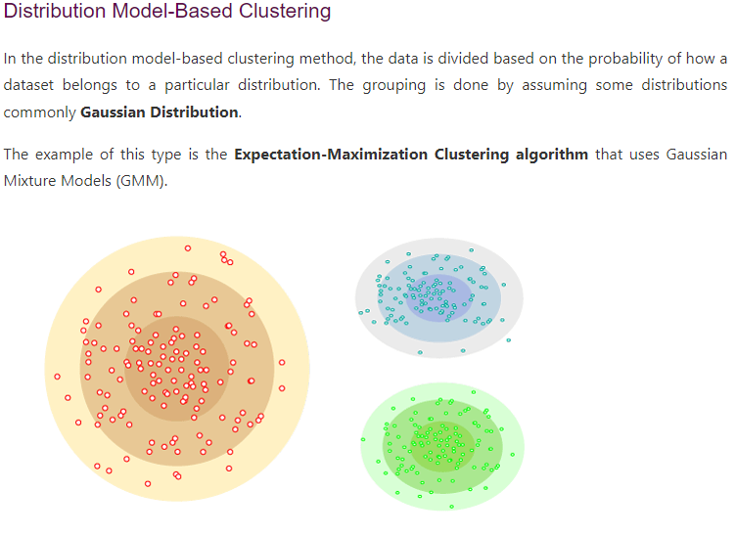

Slide 9
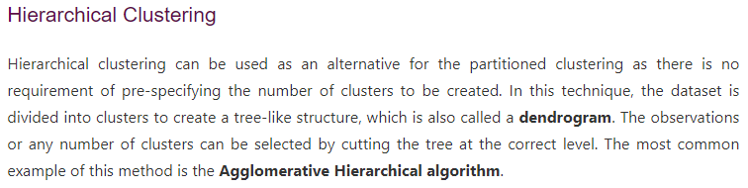
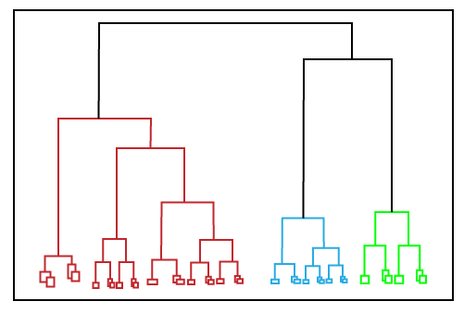

Slide 10
